Slide 1
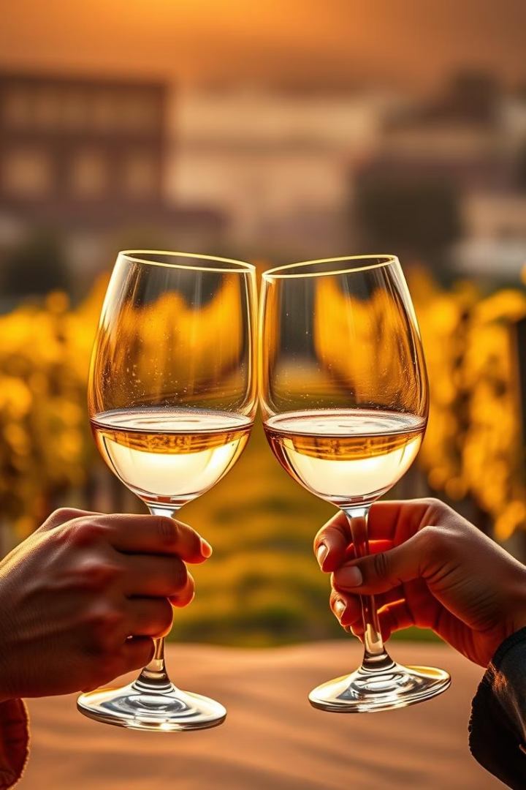
Hyperparameter Tuning for Wine Quality Classification
Balaraj (1BG23CS021)
Keerthi Y P (1BG23CS059)
Harshavardhan M (1BG23CS048)

Slide 2
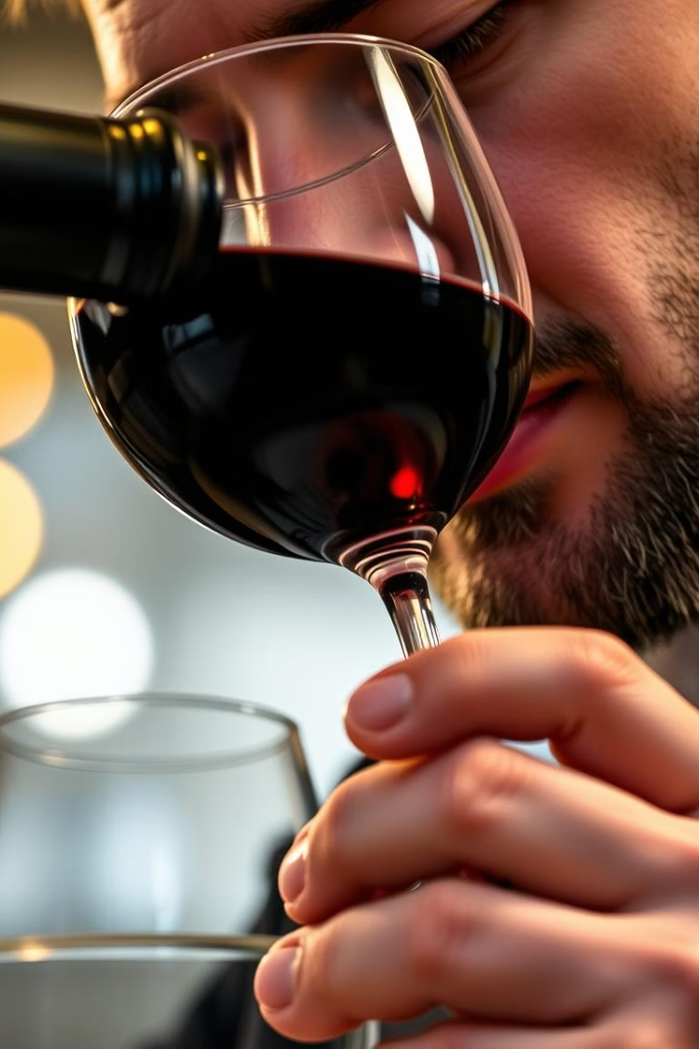
Problem Statement: Predicting Red Wine Quality
To develop a machine learning-based web application that predicts red wine quality using its chemical properties for faster and more accurate quality assessment.

Slide 3
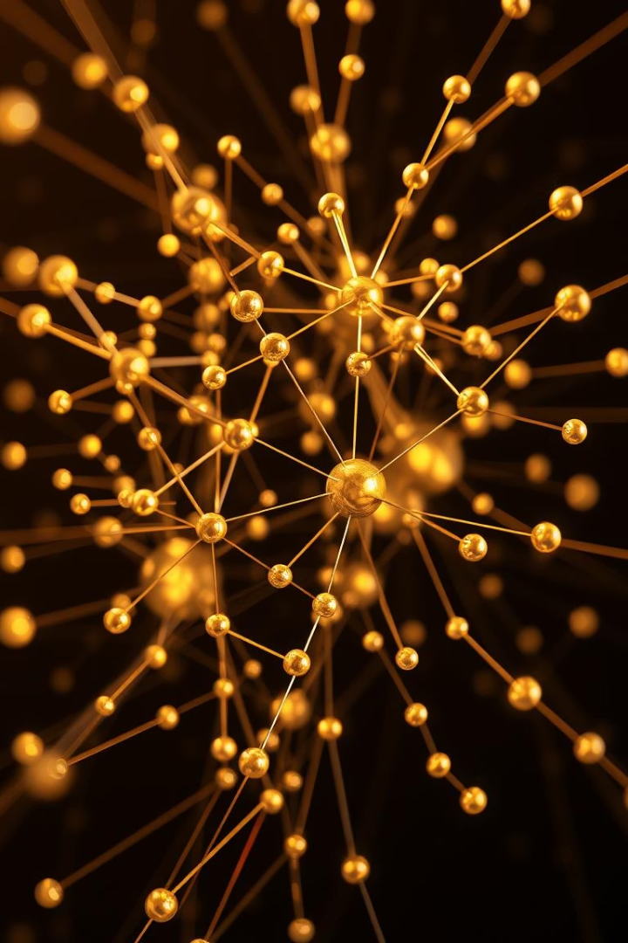
Introduction to Hyperparameter Tuning
This project aims to predict the quality of red wine using machine learning based on its physicochemical properties such as acidity, alcohol content, and sugar levels. Traditional methods of wine quality assessment are often subjective and time-consuming, but with the help of a Random Forest Classifier, this model provides a reliable and automated way to classify wine as good or not good quality. A user-friendly web application is built using Streamlit, allowing users to input wine characteristics and receive instant predictions, making the solution both accessible and practical for real-world use in quality control and production environments.

Slide 4

Objectives and Key Features
Objectives
Key Features
Analyze wine physicochemical properties.
Data Analysis & Visualization
Classify wine as good or not good.
Binary Classification Model
Develop a real-time prediction web interface.
User Input Interface
Provide simple, automated quality solutions.
Interactive Web Application

Slide 5

Conclusion: Strategic Value of Tuning
The Wine Quality Prediction project successfully demonstrates how machine learning can be applied to enhance decision-making in the wine industry by automating the quality assessment process. By using a Random Forest Classifier and an intuitive web interface, the system provides accurate, real-time predictions based on key chemical attributes of red wine. This solution not only improves efficiency and consistency but also reduces reliance on manual testing, making it a valuable tool for producers, quality analysts, and wine enthusiasts alike.

